Slide 1
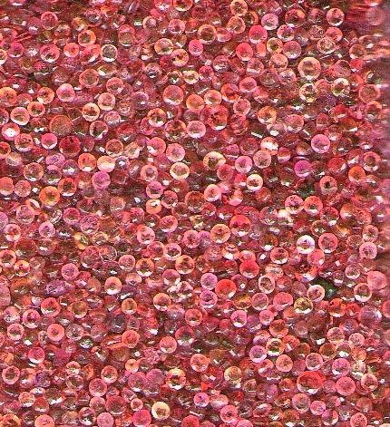
Object-oriented Programming with Ruby
Robert Batzinger
CSCI A-201
Spring 2009

Slide 2
Loops and iterators:
Repetition

Slide 3
A note about ranges
Arrays of values
Inclusive range: 0..5 [0,1,2,3,4,5]
Bounded range: 0…5 [0,1,2,3,4]
Can be used to create sub-arrays of arrays
months = [’Jan’,’Feb’,’Mar’,’Apr’,’May’,’Jun’,’Jul’,’Aug’,
’Sep’,’Oct’,’Nov’,’Dec’]
months [’Jan’,’Feb’,’Mar’,’Apr’,’May’,’Jun’, ’Jul’,’Aug’,’Sep’,’Oct’,’Nov’,’Dec’]
months[3…6] [’Apr’,’May’,’Jun’]
months[0,3,6] [’Jan’,’Apr’,’Jul’]

Slide 4
Array processing methods
grades = [93,88,99,94,96]
grades 93, 88, 99, 94, 96
grades.sort 88, 93, 94, 96, 99
grades.reverse 96, 94, 99, 88, 93
grades.shift 93
grades.pop 96
Stacking of methods
grades 93, 88, 99, 94, 96
grades.sort 88, 93, 94, 96, 99
grades.sort.reverse 99, 96, 94, 93, 88
grades.sort.reverse.shift 99
grades.sort.reverse.pop 88
grades.sort.reverse.join(”,”) “99,96,94,93,88”

Slide 5
Processing elements of an array
handling individual elements
looking up each element
grades = [88, 93, 94, 96, 99]
sum = 0
grades.each { |x|
sum += x
}
print “Average = “
puts sum / grades.size
grades = [88, 93, 94, 96 99]
sum = 0
grades.size.times { |i|
sum += grades[i]
}
print “Average = “
puts sum / grades.size
Average = 94

Slide 6
Processing elements of hash
color = {‘red’ => “#ff0000”,
“yellow” => “#ffff00”,
“green” => “#00ff00”,
“blue” => “#0000ff”,
‘purple’ => “#ff00ff”}
color.keys.each { |key|
print “Html code for “
puts “#{key} is #{color[key]}.”
}
Html code for red is #ff0000.
Html code for yellow is #ffff00.
Html code for green is #00ff00.
Html code for blue is #0000ff.
Html code for purple is #ff00ff.

Slide 7
Other hash methods
color = {‘red’ => “#ff0000”, “yellow” => “#ffff00”,
“green” => “#00ff00”, “blue” => “#0000ff”,
‘purple’ => “#ff00ff”)
color.keys ‘red’, “yellow”, “green”, “blue”, ‘purple’
color.values “#ff0000”, “#ffff00”, “#00ff00”, “#0000ff”, “#ff00ff”
color.invert
“#ff0000”=> ‘red’, “#ffff00”=>“yellow”, “#00ff00”=> “green”, “#0000ff”=> “blue”, “#ff00ff”=> ‘purple’

Slide 8
Loops
Sample Form
Basic components
i = 0
while i < 5 do
puts ’i = #{i}’
i += 1
end
Setting the initial value of a counter
Comparison of counter to a cut-off point
Payload
Loop body
Increment of counter

Slide 9
Loop in action
code
output
i = 0;
while i < 5 do
puts " i = #{i} "
i += 1
end
i = 0
i = 1
i = 2
i = 3
i = 4

Slide 10
Seven kinds of loops (1)
Key
1) Loop
Initial value
Payload
Final Set point condition
Increment
i = 0
loop do
puts " i = #{i}"
i += 1
break if i >= 5
end

Slide 11
Seven kinds of loops (2)
2) While
3) For
i = 0
while i < 5 do
puts " i = #{i}"
i += 1
end
for i in 0...5 do
puts " i = #{i}"
end

Slide 12
Seven kinds of loops (3)
4) Until
5) Loop
i=0
until i == 5 do
puts " i = #{i}"
i += 1
end
i = 0
loop do
puts " i = #{i}"
i += 1
break if i >= 5
end

Slide 13
Seven kinds of loops (4)
6) While
7) Loop
i = 0
while i < 5 do
puts " i = #{i}"
i += 1
end
i = 0
loop do
puts " i = #{i}"
i += 1
break if i >= 5
end

Slide 14
おわり The end

